Slide 1
Matching MNRS runtime with QSVT
Sharan Krishnan

Slide 2
Outline
Paper | Proofs understood
Search Via Quantum Walk (MNRS algorithm) | Yes
Fixed Point Quantum Search with Optimal Number of Queries/ Grand Unification of Quantum Algorithms | No
Counting on Chebyshev Polynomials | Yes
Mini research question: is there a QSVT algorithm that exactly matches the complexity of MNRS?
Relevance: I think the techniques explored in this simpler problem might be useful for speeding up the state-of-the-art search algorithms.

Slide 3
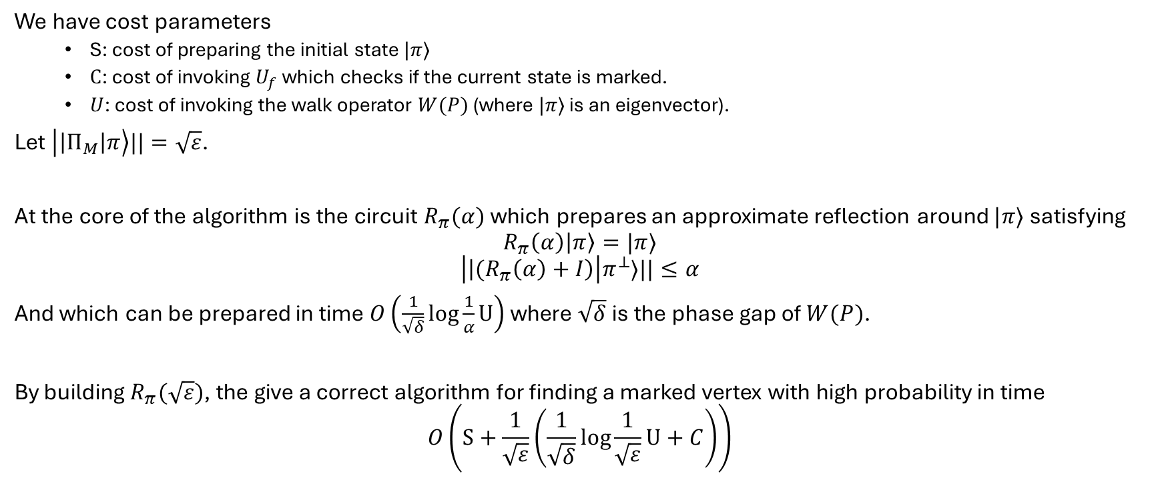
Recap on MNRS
We have cost parameters
S: cost of preparing the initial state $|π⟩$
$C$: cost of invoking $U_{f}$ which checks if the current state is marked.
$U$: cost of invoking the walk operator $W(P)$ (where $|π⟩$ is an eigenvector).
Let $\left|\left|Π_{M}\right|π\right\rangle ||=\sqrt{ε}$.
At the core of the algorithm is the circuit $R_{π}(α)$ which prepares an approximate reflection around $|π⟩$ satisfying
$$R_{π}\left(α\right)\left|π\right\rangle =|π⟩$$
$$\left|\left|{(R}_{π}\left(α\right)+I\right)\right|π^{⊥}⟩||≤α$$
And which can be prepared in time $O\left(\frac{1}{\sqrt{δ}}\log{\frac{1}{α}}U\right)$ where $\sqrt{δ}$ is the phase gap of $W(P)$.
By building $R_{π}(\sqrt{ε})$, the give a correct algorithm for finding a marked vertex with high probability in time
$$O\left(S+\frac{1}{\sqrt{ε}}\left(\frac{1}{\sqrt{δ}}\log{\frac{1}{\sqrt{ε}}}U+C\right)\right)$$

Slide 4
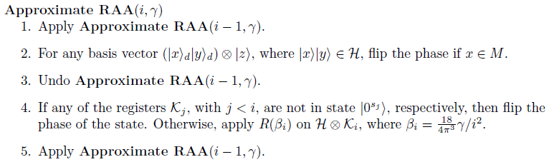
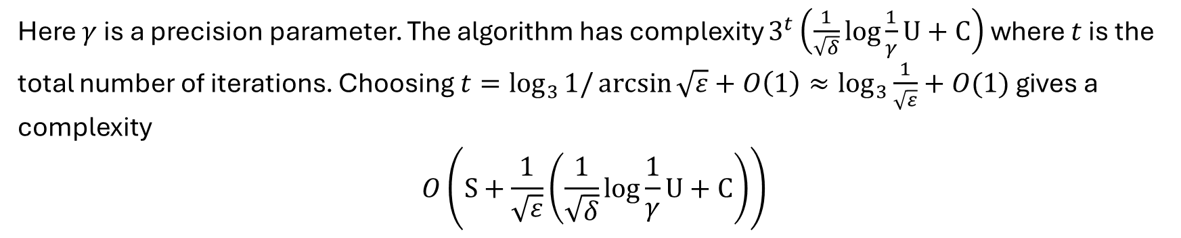
Improved Recursive Algorithm
Here $γ$ is a precision parameter. The algorithm has complexity $3^{t}\left(\frac{1}{\sqrt{δ}}\log{\frac{1}{γ}}U+C\right)$ where $t$ is the total number of iterations. Choosing $t=\log_{3}{1/\arcsin{\sqrt{ε}}}+O\left(1\right)≈\log_{3}{\frac{1}{\sqrt{ε}}}+O(1)$ gives a complexity
$$O\left(S+\frac{1}{\sqrt{ε}}\left(\frac{1}{\sqrt{δ}}\log{\frac{1}{γ}}U+C\right)\right)$$

Slide 5
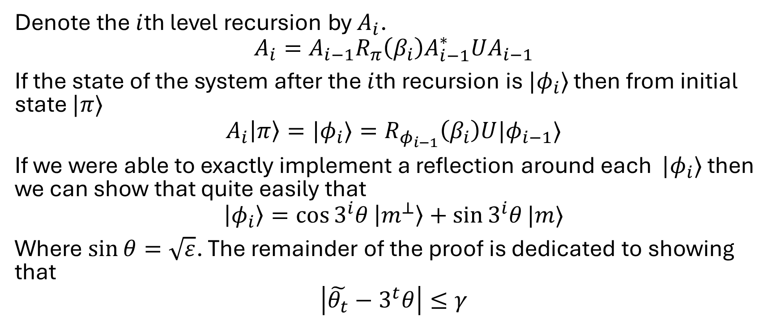
Proof sketch
Denote the $i$th level recursion by $A_{i}$.
$$A_{i}=A_{i−1}R_{π}\left(β_{i}\right)A_{i−1}^{∗}UA_{i−1}$$
If the state of the system after the $i$th recursion is $|φ_{i}⟩$ then from initial state $|π⟩$
$$A_{i}\left|π\right\rangle =|φ_{i}⟩=R_{φ_{i−1}}\left(β_{i}\right)U|φ_{i−1}⟩$$
If we were able to exactly implement a reflection around each $|φ_{i}⟩$ then we can show that quite easily that
$$\left|φ_{i}\right\rangle =\cos{3^{i}θ}\left|m^{⊥}\right\rangle +\sin{3^{i}θ}|m⟩$$
Where $\sin{θ}=\sqrt{ε}$. The remainder of the proof is dedicated to showing that
$$\left|\tilde{θ_{t}}−3^{t}θ\right|≤γ$$

Slide 6
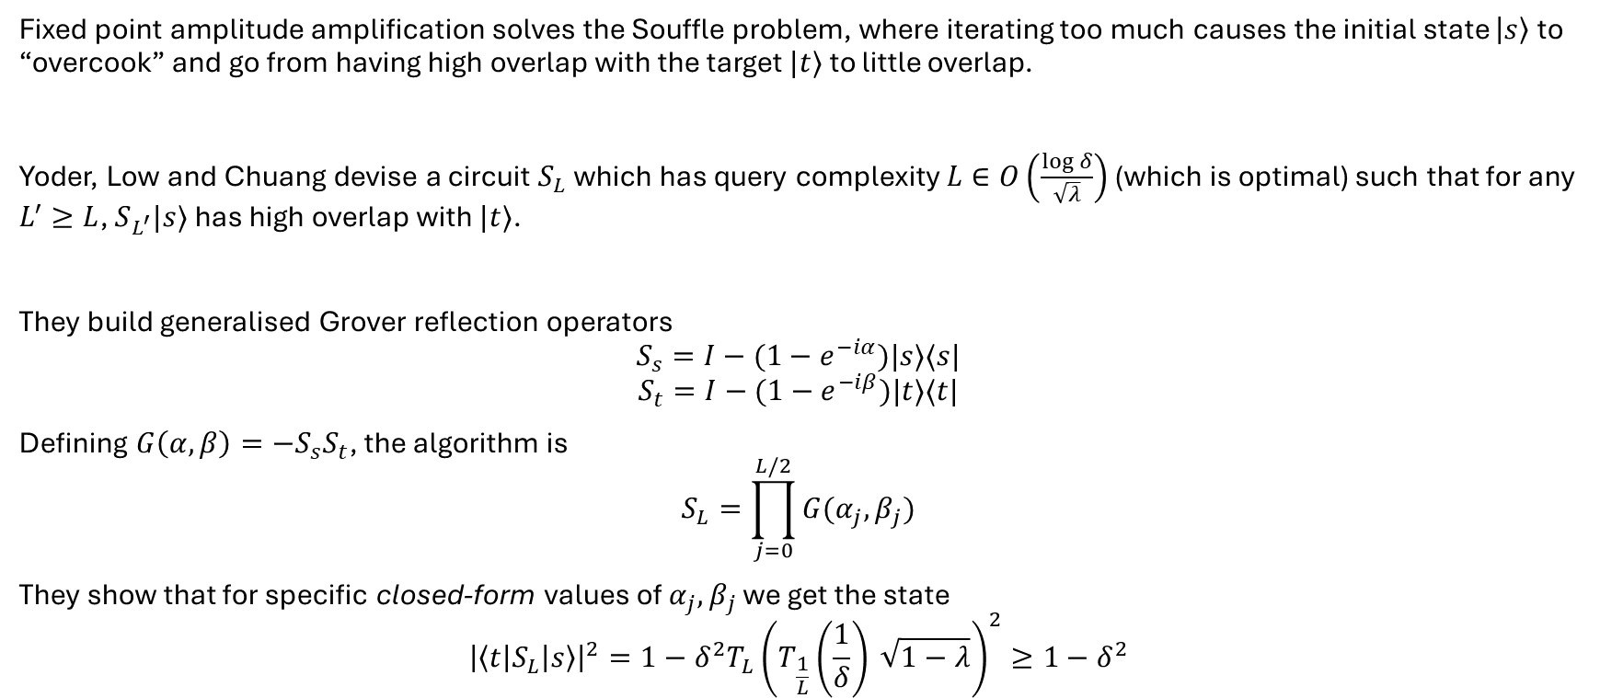
Fixed-Point Oblivious Amplitude Amplification
Fixed point amplitude amplification solves the Souffle problem, where iterating too much causes the initial state $\left|s\right\rangle$ to “overcook” and go from having high overlap with the target $|t⟩$ to little overlap.
Yoder, Low and Chuang devise a circuit $S_{L}$ which has query complexity $L∈O\left(\frac{\log{δ}}{\sqrt{λ}}\right)$ (which is optimal) such that for any $L^{′}≥L$, $S_{L^{′}}|s⟩$ has high overlap with $|t⟩$.
They build generalised Grover reflection operators
$$S_{s}=I−(1−e^{−iα})|s⟩⟨s|$$
$$S_{t}=I−(1−e^{−iβ})|t⟩⟨t|$$
Defining $G\left(α,β\right)=−S_{s}S_{t}$, the algorithm is
$$S_{L}=\prod_{j=0}^{L/2}{G(α_{j},β_{j})}$$
They show that for specific closed-form values of $α_{j},β_{j}$ we get the state
$${\left|\left\langle t\left|S_{L}\right|s\right\rangle \right|}^{2}=1−δ^{2}T_{L}{\left(T_{\frac{1}{L}}\left(\frac{1}{δ}\right) \sqrt{1−λ}\right)}^{2}≥1−δ^{2}$$

Slide 7

Proof sketch
Using the fact that $T_{k}(\cos{θ)=\cos{kθ}}$, we know that if

